Slide 1

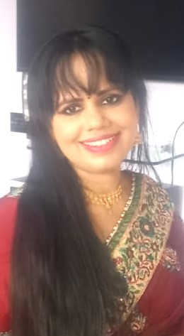

Ms. Dhritii is a Spiritual Counsellor & Advisor, Being Sensible.
She is an Astrologer, Numerologist, Vaastu Consultant , Career Counsellor and Tarot Card Reader.
She is currently considering topics relating to Education, Career, Finance, Relationship, Health, Travel, Visa, Property, Litigation, etc.
Her forte is Consultation (Prediction & Counselling) and Program (Teaching).
She is a pure soul, connected to the Divine and has been chosen by the Divine Intelligence to coach individuals in the field of Spirituality and serve the public.
Her key traits include understanding the individual with complete empathy, thinking out of the box, a solution provider, honest, agile, exercising discretion, diplomacy and tact, analytical thinking, excellent communication skills and result oriented.
Key links
1. https://beingsensibles.com/contact/
2. http://www.youtube.com/@DhritiiS
3. http://www.linkedin.com/in/
4. https://www.instagram.com/divine_dhritii/?hl=en
Dhritii,
Spiritual Counsellor & Advisor,
Being Sensible

Slide 2
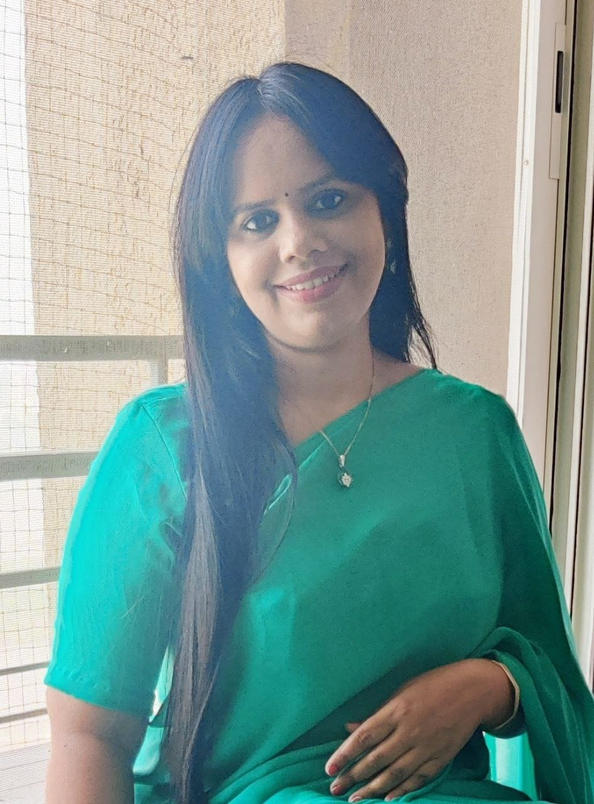
This is her second phase of her career wherein she is completely committed to the field of spirituality whereas her first phase of life is inspirational, in terms of her academic and professional accomplishments.
Her real name is Ms. Falguni Sanghvi and she is Harvard certified (Negotiation Mastery & Management Essentials), Corporate Legal Professional & Chartered Secretary (India & UK) with around 20 years of experience in Commercial Legal Operations, Risk Assessment - Tenders, Contract Management, Advisory and Litigation, Compliance Management and Company Secretarial matters across Information Technology, Financial Services, Real Estate, Telecommunications, Manufacturing, Brokerage and Business Consulting.
Her experience also includes her dealing with international and domestic clients with complete excellence, passion and utilizing her expertise to resolve their challenges.
.
Dhritii,
Spiritual Counsellor & Advisor, Being Sensible

Slide 3
Thank you
Dhritii,
Spiritual Counsellor & Advisor,
Being Sensible
Beingdivineandblissful@gmail.com
9372676330
WhatsApp / call
(Mon – Fri – 3 p.m. – 8 p.m.)

